Slide 1
Perceived and Actual Consequences of the Foreign Account Tax Compliance Act: A Survey of Americans Living Abroad
Sonja Pippin
Jeff Wong
Richard Mason
University of Nevada, Reno

Slide 2
Today’s Presentation
Background and motivation for study
Current status of study
Research questions
Survey participants
Findings and first conclusions

Slide 3
FATCA (Foreign Account Tax Compliance Act)
FATCA grew out of the rule that American citizens and permanent residents are taxed on worldwide income, regardless of where they live.
There was concern that assets held abroad would generate U.S. taxable income that is not reported.
Foreign financial institutions are required to report information on financial accounts held directly or indirectly by U.S. persons.
Certain U.S. taxpayers holding financial assets outside the U.S. must report those assets to the IRS (e.g. aggregate value > $50,000)
Taxpayers must still comply with other reporting requirements for U.S. taxpayers living abroad (e.g. FBAR)

Slide 4
Penalties for FATCA Noncompliance
Failure to report foreign financial assets on Form 8938 will result in a penalty of $10,000 (and a penalty up to $50,000 for continued failure after IRS notification). Further, underpayments of tax attributable to non-disclosed foreign financial assets will be subject to an additional substantial understatement penalty of 40 percent.
IRS summary of Key FATCA Provisions
https://www.irs.gov/businesses/corporations/summary-of-key-fatca-provisions

Slide 5
Motivation for Study
Most Americans living abroad will probably have foreign financial accounts as well as interest in other foreign financial assets. Many, if not most, will be subject to the FATCA reporting requirements.
Our study was designed to assess the perceived impact of the FATCA on taxpayer’s abroad, and their perceptions of the law.

Slide 6
Current Status of Study
The paper is fairly raw at the moment.
We are thinking about how best to frame the study and the most appropriate outlet to which to submit it.
Any input is appreciated.

Slide 7
Contribution to the Literature
Our paper examines individuals’ experiences with, and perceptions of, the foreign tax reporting rules which we contrast against the intent of these provisions.

Slide 8
Research Questions
Do Americans living abroad have a generally favorable or unfavorable view of U.S tax law as it relates to their living overseas?
How do Americans living abroad perceive the problem of tax evasion in the United States and in the country of residence?
What is the impact of FATCA on American citizens abroad?

Slide 9
Survey and Participants
We partnered with the American Citizens Abroad Global Foundation (ACAGF) to create the survey.
The survey was pre-tested on a focus group of researchers, pilot tested on 60 students, then opened to participants.
The resulting survey consisted of 36 questions.
The ACAGF invited Americans living abroad to participate in survey via social media sites.
684 people responded to the survey.

Slide 10
RQ1: Do Americans living abroad have a generally favorable or unfavorable view of U.S tax law as it relates to their living overseas?
Responses indicate an unfavorable view.

Slide 11
RQ2: How do Americans living abroad perceive the problem of tax evasion in the United States and in the country of residence?
Responses indicate that participants do not see tax evasion as a major problem, but do think some effort is needed to combat this crime.

Slide 12
RQ3: What is the impact of FATCA on American citizens abroad?
1 of 3

Slide 13
RQ3: What is the impact of FATCA on American citizens abroad?
2 of 3

Slide 14
RQ3: What is the impact of FATCA on American citizens abroad?
3 of 3

Slide 15
FATCA in the News
“400,000 US Expats Ready To Renounce Citizenship Over FATCA.” According to a poll by international tax service Greenbacks which asked Americans living overseas if they plan to give up their citizenship because of the Foreign Account Tax Compliance Act (FATCA) (iExpats.com, June 2, 2017)
“Americans Renouncing Citizenship Hits New Record; Tax Bill Won’t Change That” (Forbes.com, Nov 3, 2017)
“By the end of the year and estimated 6,813 Americans living overseas will renounce their citizenship, according to new numbers from the Treasury Department and projections by Bloomberg News.” (Newsweek.com, Nov 2, 2017)

Slide 16
Findings
Americans living overseas overwhelmingly dislike FATCA.
Complex, burdensome, unnecessary
Competitive disadvantage
Changes perception of others in their country of residence
Impacts voting behavior for some
Other perceptions: “Soft factors”
Left alone
U.S. Government does not care
Unfair and unjust treatment
Treated like criminals

Slide 17
Conclusion: What Can Be Done?
Same country exception
Information campaign
Compliance help for U.S. taxpayers living abroad (free filing initiatives)
Increase thresholds; decrease penalties
Amnesty

Slide 18
Thank you!
Questions?
Comments?

Slide 19
Foreign Tax Reporting Rules
Report of Foreign Bank and Financial Accounts FBAR | Foreign Account Tax Compliance Act FATCA
U.S. Persons must file a report if they have signature authority, financial interest or other authority over financial accounts and at any point during the calendar year the aggregate value of all these accounts exceeds $10,000 (even if this is only for one day) | U.S. persons must file a report if the aggregate value of certain specified foreign financial assets at any point during the calendar year exceeds $50,000 (even if this is only for one day)
“Foreign financial accounts” includes: Checking account Savings account Money market account Debit card account (and possibly credit card account) | “Foreign financial assets” includes: Any financial account maintained by a foreign financial institution Any stock or security issued by a non-U.S. person Any financial interest or contract held for investment that has a non-U.S. issuer or counterparty Any interest in a foreign entity

Slide 20
Foreign Tax Reporting Rules (continued)
Report of Foreign Bank and Financial Accounts FBAR | Foreign Account Tax Compliance Act FATCA
FinCEN 114 (filed electronically) to report financial information for all applicable accounts | Form 8938 to report financial information for all foreign deposit and custodial accounts and certain other foreign assets including address and ownership, account balance (or maximum value) and interest, dividends, royalties and other income earned
Penalties start with $10,000 and increase by $10,000 for each 30-day period after being notified by the U.S. Treasury with a maximum of $50,000 (plus interest). If taxpayers can demonstrate reasonable cause the penalty may be waived. | Penalties start with $10,000 penalty per account (up to six years of non-filing) if the IRS finds that the failure was not willful or 50% of the account balance (capped at $100,000) for willful non-filing.

Slide 21
Respondent’s Country of Residence

Slide 22
Respondent’s Reasons for Living Abroad

Slide 23
Respondent’s Citizenship Status

Slide 24
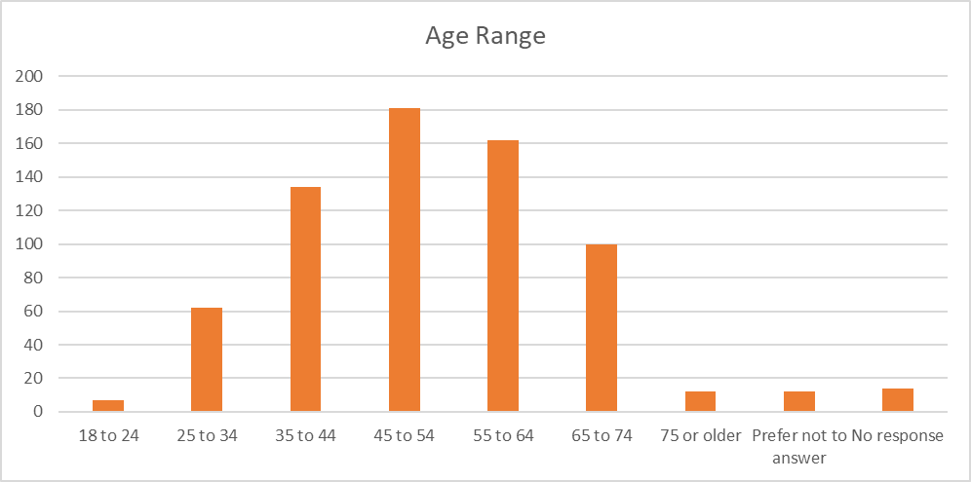
Age of Respondents

