Slide 1
The Economic and Fiscal Impacts of Property Tax Abatement in a Large Ohio County
Daphne A. Kenyon Resident Fellow in Tax Policy, Lincoln Institute of Land Policy
Adam H. Langley Senior Research Analyst, Lincoln Institute of Land Policy
Bethany P. Paquin Research Analyst, Lincoln Institute of Land Policy
Robert W. Wassmer, Ph.D.
Professor, California State University, Sacramento

Slide 2
Acknowledgements
Liliana Rivera and Sydney Zelinka for their valuable research assistance
Expertise and data resources/support of the Franklin County (Ohio) Auditor Clarence Mingo, Mark Potts, and the staff of the Franklin County Auditor’s Office
Professors Robert Greenbaum, Andrew Hanson, and Edward “Ned” Hill offered valuable insights
Franklin County Auditor’s Office and the Lincoln Institute of Land Policy provided the funding necessary to complete this research

Slide 3
Takeaways
Panel data regression analysis of the economic and fiscal effectiveness of two major property tax abatement programs – Community Reinvestment Areas (CRAs) and Enterprise Zones (EZs) – in Franklin County, Ohio
A one-percentage point increase in a school district’s CRA or EZ abatement intensity correlates with: (1) a 2.7 percent decrease in a school district’s mill rate for real property, (2) a 0.9 (0.7) percent decrease in effective residential (non-residential) property tax rates, and (3) a 1.6 percent increase in the total market value of property in the school district
A one standard deviation increase in CRA/EZ abatement as a percent of a school district’s total property value lowers the average residential property tax bill in that school district for that year by about $100

Slide 4
Takeaways
While detected effects small
Any reduction in residential property tax bill a positive outcome since tax incentives have generated enough growth in property values to offset the immediate drop in the tax base from an abatement and thus avoid a tax shift to non-abated properties.
There may be other positive impacts (greater employment, less blight, etc.) that we do not measure.

Slide 5
Background
Bartik (2017) estimate that in 2015 state & local annual business incentives $45B
Bidding for Business
Amazon HQ2 garnered 238 separate proposals
Potential revenue foregone that may never materialize if incentive never offered
Call for greater info and scrutiny (Good Job First, GASB77) on whether benefits > costs
Study initiated by Franklin County Auditor

Slide 6
Property Tax Abatement (Incentives) in Ohio
Community Reinvestment Areas (CRAs) provide tax exemptions to residential, commercial, or industrial property in specific geographic areas
After public notification of intent, a city council or county commission may adopt a resolution establishing a CRA within its boundaries if “the area included in the description is one in which housing facilities or structures of historical significance are located and new housing construction and repair of existing facilities or structures are discouraged”
Original intent of CRAS was property tax relief for construction or remodeling of housing, but most of the current tax savings under the CRA program goes to industrial and commercial development
Post-1994 CRAs require approval and written agreement on what business promises in return (increased jobs, payroll, investment, etc.)

Slide 7
Property Tax Abatement (Incentives) in Ohio
Enterprise zones (EZs) offer non-residential property tax exemption on new real property inside the zone’s perimeter, and a reduction in the corporate franchise tax
In practice, not geographically targeted
Agreements with qualifying enterprises for incentives tied to investment and hiring.
Inside a municipality, the maximum exemption from property taxation is 75 percent of the assessed value for up to 10 years
$65.4 million in tax savings from Franklin County CRA and EZ abatements in 2015
52% in pre-1994 CRA zones, 38% in post-1994 CRA zones, and 10% in Ezs
Most abated properties are residential, but most tax savings go to industrial properties
Average annual tax savings of $228,675 per parcel

Slide 8
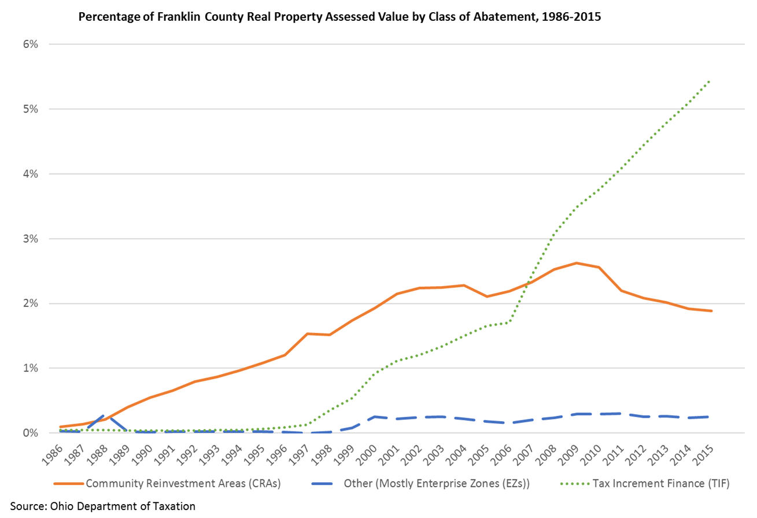
TIF in Ohio is called an abatement, but in practice it does not work like an abatement since the business still pays “service fees” that are equal to what they would have paid in property taxes.

Slide 9
Property Tax Abatement (Incentives) in Ohio
Two other Ohio tax incentives available in Ohio
Environmental Protection Abatements (EPA) that promote brownfield development
1/50th use of CRA/EZ abatements
Job Creation Tax Credits (JCTCs)
Refundable credits against state individual income tax, corporate income taxes, and/or insurance premiums tax
Must demonstrate that the project will create/retain jobs, is economically sound, and that the incentive is a major factor in the decision to go forward with the project
Agreements spell out: (1) duration (up to 15 years), (2) operate at the location for at least seven years or three years after the end of the incentive (whichever is greater), (3) tax credit (between 50 and 75 percentage of a firm’s new or retained payroll), (4) reporting requirements, (5) claw back provision, and (5) restricting relocation of jobs within the state

Slide 10
Simple Model
Property Tax Rate = Local Education Expenditure / Taxable Property Value
Local Education Expenditure = f (Resident Characteristics that Influence Demand)
Taxable Property Value = f (Property Tax Abatement, Other Property Relevant Incentives, Property Exempt from Taxation, Property Base Characteristics)
Resident Characteristics that Influence Demand = f (Bachelor_Plus_Percent , Age19_Less_Percent, Enrollment)
Property Tax Abatement = f (CRA/EZ_Abate_Percent, CRA_Pre94_Percent)
Other Property Relevant Incentives = f (TIF_Abate_Percent, EPA_Abate_Percent, JCTC_Jobs_Per_100M_MarketVal)
Property Exempt from Taxation = f (Tax_Exempt_Property_Percent)
Property Base Characteristics = f (Number_Parcels, Parcels_NonResidential_Percent)
Property Tax Rate = f (Bachelor_Plus_Percent, Enrollment, CRA/EZ_Abate_Percent, CRA_Pre94_Percent, TIF_Abate_Percent, EPA_Abate_Percent, Exempt_Percent, JCTC_Jobs_Per_100M_MarketVal, Parcels_Number, Parcels_NonResidential_Percent)
Taxable Property Value = f (Bachelor_Plus_Percent, Age19_Less_Percent, Enrollment, CRA/EZ Abate_Percent, CRA_Pre94_Percent, TIF_Abate_Percent, EPA_Abate_Percent, JCTC_Jobs_Per_100M_MarketVal, Tax_Exempt_Property_Percent, Parcels_Number, Parcels_NonResidential_Percent

Slide 11
Fiscal Impact Regression Results Using Franklin County School District Data
(16 Franklin County School Districts drawn from 18 years between 1998 and 2015)
Dependent Variable: Ln_School_Mills_Real
School district fixed effects and year dummy variables included, but not reported.
Heteroscedastic and autocorrelated robust standard errors through clustering on school districts.
Statistical significance measured in two-tailed test: *** > 99%, **95 to 99%, and *90 to 95%.
^Within R-Squared measures the variance within the panel units (school districts) accounted for by the regression model.
Explanatory Variable | Regression Coefficient | Statistical Significance | Regression Coefficient Robust Standard Error | 90% Confidence Interval
Bachelor_Plus_Percent | 0.0071 | * | (0.0071) | 0.00049 to 0.014
Age19_Less_Percent | -0.026 | *** | (0.0091) | -0.041 to -0.011
Ln_Enrollment | 0.51 | ** | (0.095) | 0.35 to 0.66
CRA/EZ_Abate_Percent | -0.027 | *** | (0.0041) | -0.034 to -0.021
CRA_Pre94_Percent | 0.00027 |  | (0.00027) | -0.00017 to 0.00071
TIF_Abate_Percent | -0.019 | *** | (0.0059) | -0.028 to -0.0089
EPA_Abate_Percent | -0.069 |  | (0.081) | -0.20 to -0.064
JCTC_Jobs_Per_100M_MarketVal | -0.00019 | * | (0.00011) | -0.00036 to 0.000015
Tax_Exempt_Property_Percent | -0.0013 |  | (0.0026) | -0.0056 to 0.0029
Ln_Parcels_Number | 0.12 |  | (0.18) | -0.19 to 0.42
Parcels_NonResidential_Percent | -0.025 | *** | (0.0054) | -0.034 to -0.016
Within R-Squared^ | 0.755
Observations | 288

Slide 12
Fiscal Impact Regression Results Using Franklin County School District Data
(16 Franklin County School Districts drawn from 18 years between 1998 and 2015)
Dependent Variable: Ln_Residential_Effective_Real_Rate
School district fixed effects and year dummy variables included, but not reported.
Heteroscedastic and autocorrelated robust standard errors through clustering on school districts.
Statistical significance measured in two-tailed test: *** > 99%, **95 to 99%, and *90 to 95%.
^Within R-Squared measures the variance within the panel units (school districts) accounted for by the regression model.
Explanatory Variable | Regression Coefficient | Statistical Significance | Regression Coefficient Robust Standard Error | 90% Confidence Interval
Bachelor_Plus_Percent | -0.0013 |  | (0.0026) | -0.0056 to 0.0030
Age19_Less_Percent | -0.026 | ** | (0.0060) | -0.035 to -0.016
Ln_Enrollment | 0.40 | *** | (0.063) | 0.29 to 0.50
CRA/EZ_Abate_Percent | -0.0086 | *** | (0.0027) | -0.013 to -0.0041
CRA_Pre94_Percent | -0.000080 |  | (0.00018) | -0.00037 to 0.00021
TIF_Abate_Percent | -0.0024 |  | (0.0039) | -0.0088 to 0.0040
EPA_Abate_Percent | -0.054 |  | (0.053) | -0.14 to 0.033
JCTC_Jobs_Per_100M_MarketVal | -0.000066 |  | (0.000069) | -0.00018 to 0.000049
Tax_Exempt_Property_Percent | 0.00090 |  | (0.0017) | -0.0019 to 0.0037
Ln_Parcels_Number | -0.090 |  | (0.12) | -0.29 to 0.11
Parcels_NonResidential_Percent | -0.0085 | ** | (0.0035) | -0.014 to -0.0027
Within R-Squared^ | 0.873
Observations | 288

Slide 13
Economic Impact Regression Results Using Franklin County School District Data
(16 Franklin County School Districts drawn from 18 years between 1998 and 2015)
Dependent Variable: Ln_Real_Property_Market_Value
School district fixed effects and year dummy variables included, but not reported.
Heteroscedastic and autocorrelated robust standard errors through clustering on school districts.
Statistical significance measured in two-tailed test: *** > 99%, **95 to 99%, and *90 to 95%.
Explanatory Variable | Regression Coefficient | Statistical Significance | Regression Coefficient Robust Standard Error | 90% Confidence Interval
Bachelor_Plus_Percent | 0.010 | *** | (0.0019) | 0.0072 to 0.013
Age19_Less_Percent | 0.0052 |  | (0.0042) | -0.0019 to 0.012
Ln_Enrollment | 0.039 |  | (0.045) | -0.035 to 0.11
CRA/EZ_Abate_Percent | 0.016 | *** | (0.0019) | 0.012 to 0.019
CRA_Pre94_Percent | 0.00047 | *** | (0.00013) | 0.00026 to 0.00068
TIF_Abate_Percent | 0.011 |  | (0.0028) | 0.0061 to 0.015
EPA_Abate_Percent | -0.053 |  | (0.038) | -0.19 to 0.08
JCTC_Jobs_Per_100M_MarketVal | 0.000016 |  | (0.000085) | -0.12 to 0.0091
Tax_Exempt_Property_Percent | 0.0056 | *** | (0.0012) | 0.0036 to 0.0076
Ln_Parcels_Number | 0.71 | *** | (0.087) | 0.57 to 0.87
Parcels_NonResidential_Percent | -0.0017 |  | (0.0025) | -0.0058 to 0.0025
Within R-Squared^ | 0.970
Observations | 288

Slide 14
Economic Impact Regression Results Using Franklin County Census Tract Data
(284 Franklin County Census Tracts drawn from 14 years between 2002 and 2015)
Dependent Variable: Ln_Real_Property_Market_Value.
Census Tract fixed effects and year dummy variables included, but not reported.
Heteroscedastic and autocorrelated robust standard errors through clustering on school districts.
Statistical significance measured in two-tailed test: *** > 99%, **95 to 99%, and *90 to 95%.
Explanatory Variable | Regression Coefficient | Statistical Significance | Regression Coefficient Standard Error | 90% Confidence Interval
CRA/EZ_Abate_Percent | 0.0042 | ** | (0.0021) | 0.00073 to 0.0077
CRA_Pre94_Percent | 0.00017 |  | (0.00019) | -0.00014 to 0.00048
TIF_Abate_Percent | 0.014 | *** | (0.0017) | 0.011 to 0.017
EPA_Abate_Percent | -0.0024 |  | (0.0060) | -0.012 to 0.0074
JCTC_Jobs_Per_100M_MarketVal | 0.000086 | ** | (0.000037) | 0.000025 to 0.00015
Tax_Exempt_Property_Percent | 0.0086 | *** | (0.0024) | 0.0047 to 0.013
Ln_Parcels_Number | 0.44 | *** | (0.13) | 0.24 to 0.65
Parcels_NonResidential_Percent | -0.0013 | *** | (0.0014) | -0.0037 to -0.0011
Within R-Squared | 0.547
Observations | 3,976

Slide 15
Conclusion
In 2015, tax savings from CRA and EZ abatements equaled 3 percent of property taxes paid in Franklin County, Ohio
We used panel-data regression analysis to estimate the impact of Community Reinvestment Areas (CRAs) and Enterprise Zones (EZs) on property value and school property tax rates in this county
We found that the use of CRAs and EZs increased property values and decreased property tax rates as intended
Regression analysis reveals that CRA or EZ property tax abatement have exerted both positive fiscal and economic impacts in Franklin County

Slide 16
Policy Implications
Found modestly beneficial effects on property values and tax rates. We believe there are at least two reasons for this beneficial effect
Ohio does not make as extensive use of business tax incentives as some other states (Bartik 2017)
The mandated use of annual Tax Incentive Review Councils may shine the light on particularly ineffective tax incentives and lead them to there more discretionary and thus effective use
Suggest policymakers consider three courses of action
Aim for limited, and not aggressive, use of property tax abatements to encourage economic development
Consider requiring an annual review process like Ohio’s tax incentive review councils. Through this mechanism they can at least determine whether businesses have generated or retained the promised jobs, payroll, or investment
Add periodic reviews that go beyond tax incentive review councils to attempt to determine, as this study did, whether the jobs, payroll, or investment associated with business incentives would have materialized without the incentives

