Slide 1
Learning to Live Without Form 1040
Katie Pratt
Professor of Law and Sayre Macneil Fellow
Loyola Law School Los Angeles
NTA Annual Meeting
November 9, 2017

Slide 2
Impetus for the paper
The Graetz Competitive Tax Plan
Graetz proposes
A new partial replacement VAT
Increase PEs to $50,000/$100,000
100 million US households no longer would file Form 1040 tax return
Graetz briefly discusses the need to replace the EITC if his plan is adopted
But there is more to consider if 100 million Form 1040 tax returns disappear

Slide 3
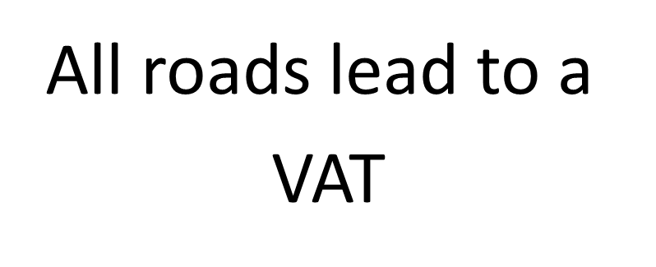
Why do we care?
VAT

Slide 4
Questions I initially considered:
What functions does the mass filing of Form 1040 serve?
Would we want to continue each of those functions?
If so, how might we replace those functions if 100 million Form 1040 tax returns disappear?

Slide 5
The initial project: Steps to analyze functions served by mass Form 1040 filing
Identify functions served by mass Form 1040 tax return filing
For each function, consider the implications of elimination of millions of Form 1040 returns
Decide whether to keep or eliminate each function
If keeping it, consider how to reform it
Opportunities
Risks

Slide 6
Second part of the project as it developed: Explore EITC & CTC reform in more detail
One function of Form 1040 is to deliver income assistance in the form of the EITC & CTC
Form 1040 changes create opportunity to improve EITC & CTC
Rethink goals and design of EITC & CTC: eligibility, phaseouts, payment intervals, & delivery mechanism
Consider alternatives: basic income; minimum wage
Risks of redesigning EITC & CTC
Politics of EITC & CTC reform
Intended and unintended consequences

Slide 7
Functions served by mass Form 1040 filing
Assessment and collection of revenue
Administration of TEs, including:
“Bad” TEs that should be eliminated
“Good” TEs that should not be eliminated
Collection of data by federal government
Promotion of “fiscal citizenship”
Income verification

Slide 8
“Fiscal citizenship” function
Larry Zelenak’s defends mass Form 1040 filing:
He argues that mass annual Form 1040 filing promotes “warm glow” of “fiscal citizenship”
But
Dysfunctional form of civic participation
Form 1040 filing disaggregates taxes and spending
Rules are complex and frustrating
Most TPs delegate: pay preparer or buy software
An annual invoice of taxes and spending (similar to sales receipt) would promote “warm glow” “fiscal citizenship” better than Form 1040 filing

Slide 9
Income verification function
Form 1040 is commonly used to verify income
Taxpayers provide their Form 1040 in private and public interactions with third-parties
Benefit program application
Lease application
FAFSA
Bank loans
Legal proceedings (e.g., bankruptcy proceeding, marital dissolution) in which parties are required to provide financial information
Form 1040 is the de facto financial statement for most households

Slide 10
Income verification function
If we keep Form 1040
We could simplify Form 1040 filing with
Federal “ready-return” tax reconciliation
Simpler individual income tax rules
Increase SD
Phase out IDs
Eliminate TEs
If millions of Form 1040s disappear, what would substitute for Form 1040?

Slide 11
Income verification function: Substitutes for Form 1040
Income verification substitute
Current third-party reporting (e.g., W-2s and 1099s) could substitute for Form 1040
Keep federal third-party info reporting even if millions of Form 1040 tax returns disappear
Alternative: Opportunity to develop better standardized forms of financial statements
Take into account information currently omitted from tax returns
Federal tax info is not the only info that matters

Slide 12
Develop standardized financial statements
Use technology to develop standardized financial statements
Income statement
Balance sheet
Statement of cash flows

Slide 13
Develop standardized financial statements
Standardized financial statements could
Serve the income verification function
Help households budget and save
Consolidate financial information
Streamline benefit program application
Increase benefit program uptake
Reduce benefit program administrative costs
Reduce benefit program “fraud” & error

Slide 14
Relationship between financial info and benefit program eligibility
Benefit program eligibility rules require info re:
Income (including transfers)
Balance sheet (net worth)
Cash flows (liquidity)
Economic unit varies program to program
Phaseouts vary program to program
Interaction of programs results in effective tax rates in excess of 100% in the phaseout ranges

Slide 15
Eliminating mass Form 1040 filing could facilitate reform of “bad” TEs
Opportunity: Graetz argues that his proposal would facilitate reform (elimination) of most TEs
Risk: TE pigs will be back for more
Shore up general elimination of TEs
Enact “framework legislation”
For new TEs, require
Congressional statement of purpose,
Measurable outcomes, and
Periodic performance review

Slide 16
Eliminating mass Form 1040 filing requires reform of “good” TEs
Keep and possibly increase anti-poverty subsidies
Existing subsidies (EITC & CTC) need to be administered and delivered
Anti-poverty subsidies may need to be increased, e.g., if new federal VAT is enacted
Opportunities
Reform existing anti-poverty TEs: EITC & CTC
Graetz plan envisions new regressivity offsets
New conditional or universal “basic income” proposals
Risks: Concerns regarding costs, salience, political economy, symbolism, “optics”

Slide 17
Graetz proposal for EITC reform
Graetz proposes new forms of regressivity offsets ─ not based on filing Form 1040:
Employers divert $ from aggregate payroll tax collections to
Pay employees benefits, or
Reduce payroll taxes of benefit recipients, or
Government sends benefit recipients “smart” cards

Slide 18
If new VAT, consider regressivity offsets for unemployed persons
EITC does not help unemployed persons
Replacement might not help unemployed persons
Could:
Increase other anti-poverty subsidies, e.g. SNAP
Exempt necessary goods from new VAT
Provide for universal VAT “prebates”
Provide for conditional or universal basic income instead of EITC conditioned on paid work
Unemployed persons include disabled, elderly, students, unpaid caregivers, workers in transition

Slide 19
Opportunity: Rethink design of anti-poverty TEs
Rethink EITC & CTC rules
Payment intervals
Eligibility requirements
Per household or per person benefit structure
Phaseout of benefits
Delivery mechanism
Promote liquidity/savings so TPs can cope with income volatility & economic shocks
Reduce EITC “fraud” rate & IRS cost of administration
Alternatives: basic income; increase minimum wage

Slide 20
EITC reform: Payment intervals
Increase payment intervals but preserve “savings” option
TP election to advance EITC in paychecks was repealed because TPs did not make the election
Low-income TPs like the “savings” aspect of annual EITC, but are hurt by liquidity traps:
Income is volatile month to month and year to year
They have little/no savings to absorb economic shocks
They do not have ready access to commercial credit
Result: payday loans and downward economic spirals
Chicago pilot program increased frequency of payments

Slide 21
EITC reform: Promote savings/liquidity
Current EITC policy focus is on increasing income
Focus also on promoting savings/liquidity
Savings would help low-income households weather liquidity shocks that currently trap them
Consistent with mental accounting, pay EITC into segregated “savings account” (with immediate access)
Permit limited “advances” against future EITC
Problem: Many low-income TPs are “unbanked”

Slide 22
Future work
Compare
Current EITC & CTC
Increase minimum wage
Len Burman’s $10,000/year Universal Wage Credit/CTC
$10,000/year UBI
Vary
Funding mechanism: new partial-replacement VAT or increase in payroll tax or income tax
Payment intervals: monthly, quarterly, annual
Advance payment (loan against future benefit) option
Assume
TPs experience income volatility and periodic economic shocks; factor in TP responses, e.g., payday loans
Composition of the household varies over time

