Slide 1
THE DYNAMIC EFFECTS OF ELIMINATING OR CURTAILING THE HOME MORTGAGE INTEREST DEDUCTION
John Diamond, George Zodrow, and Joyce Beebe
November 11, 2017
National Tax Associations 110th Annual Conference

Slide 2
Tax CUTs and Jobs Act (H.R.1)
Provisions relevant to homeownership and housing:
Preserve the home mortgage interest deduction: up to $500,000, primary residence only (from current $1 million dollars, primary residence and second home)
Allow deduction of state and local property taxes up to $10,000
Gain from sale of a principal residence: exclude up to $500,000 from taxable income, 5 out of 8 years, phasing out dollar-for-dollar for AGI exceeding $500,000 (from current 2 out of 5 years, no AGI limit)

Slide 3
NAR Reaction to Housing Related Provisions in Tax CUTs and Jobs Act
“Eliminating tax incentives for homeownership puts home values and middle-class homeowner at risk. Homeowners could lose substantial equity from the more than 10% drop in home values likely to result if the bill is enacted.”

Slide 4
NAHB Reaction to Housing Related Provisions in Tax CUTs and Jobs Act

Slide 5
Agenda
Introduction
Background Information of Mortgage Interest Deduction (MID)
Overview of the Model and Initial Equilibrium
Simulation Results
Conclusion

Slide 6
I. introduction

Slide 7
Introduction
Home Mortgage Interest Deduction (MID) is one of the largest individual income tax expenditures
Increasing debt and deficit – both tax reform and spending cuts are necessary
MID is popular, hence politically sensitive
Primary rationale is to promote home ownership, but
Current MID not well designed to achieve this goal
Provides no subsidy to low and middle income individuals if they don’t itemize
For high income taxpayers, encourages overconsumption

Slide 8
Introduction: Recent reform proposals
National Commission on Fiscal Responsibility and Reform (2010, the Simpson-Bowles report)* would:
Replace MID with a 12% nonrefundable tax credit for interest paid
Cap at mortgage amount of $500,000
Apply to principal residence only (no second or vacation homes)
Not preclude eliminating MID if consider more sweeping reforms
Tax Reform Act of 2014 (2014, the Camp bill):
Cap at mortgage amount of $500,000
*Bipartisan Policy Center, Debt Reduction Task Force (2010) recommends that the MID be replaced with a 15 percent refundable tax credit for up to $25,000 of home mortgage interest expense on a principal residence, and also recommends eliminating the MID for second or vacation homes.

Slide 9
Introduction: Recent reform proposals (Cont’d)
House Republican Tax Reform Plan (June 2016, HRTP):
Preserve the MID
“Making the MID a more effective and efficient incentive for home ownership” – unspecified changes
Trump Administration Tax Proposal (November 2017)
Preserve the MID
Cap interest deductions to a $500,000 mortgage
Important to understand the dynamic effects of revising the current MID under the current income tax
Will draw policies analyzed from reform proposals

Slide 10
II. Background Information of Mortgage Interest Deduction

Slide 11
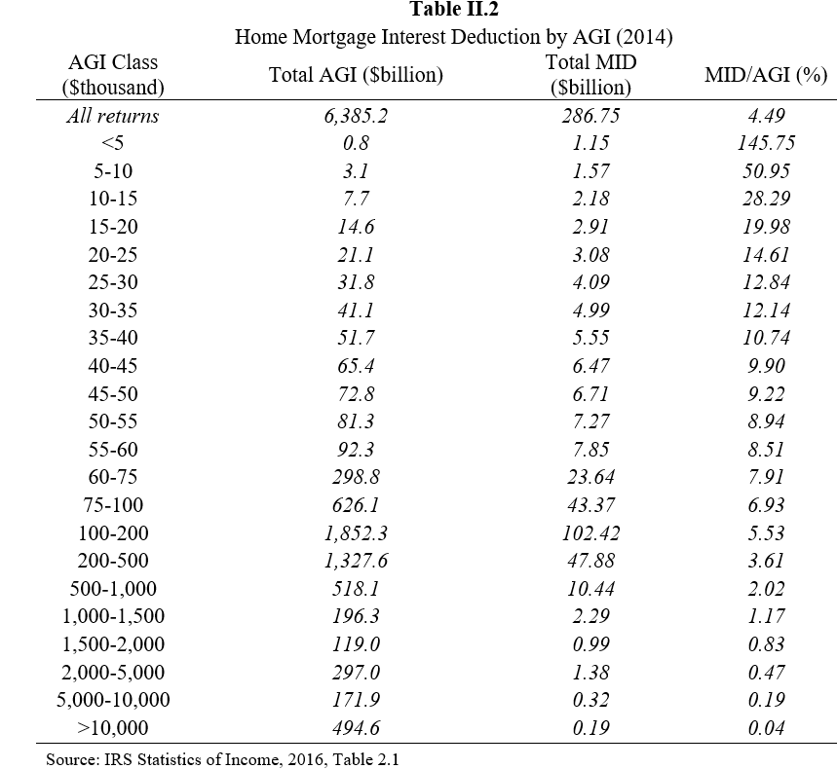
Background Information of Mortgage Interest Deduction (MID)
In 2016, tax expenditure for MID was about $59 billion (JCT, 2017) to 63 billion (OMB, 2016).
MID first increases then declines with age: But MID increases less than proportionately with AGI
Table II.1
Home Mortgage Interest Deductions by Age (2014, $billion)
Age | AGI | MID | MID/AGI (%)
All returns | 6,385 | 287 | 4.5
Under 18 | 2 | 0 | 0.9
18 to under 26 | 34 | 1 | 3.1
26 to under 35 | 490 | 26 | 5.4
35 to under 45 | 1,249 | 71 | 5.7
45 to under 55 | 1,762 | 87 | 5.0
55 to under 65 | 1,606 | 65 | 4.0
65 and over | 1,242 | 36 | 2.9
Source: IRS Statistics of Income, 2016, Table 2.6
Notes:
This may simply reflect higher income HH owns more expensive homes – next see different definition of income by P&S – consistent results

Slide 12
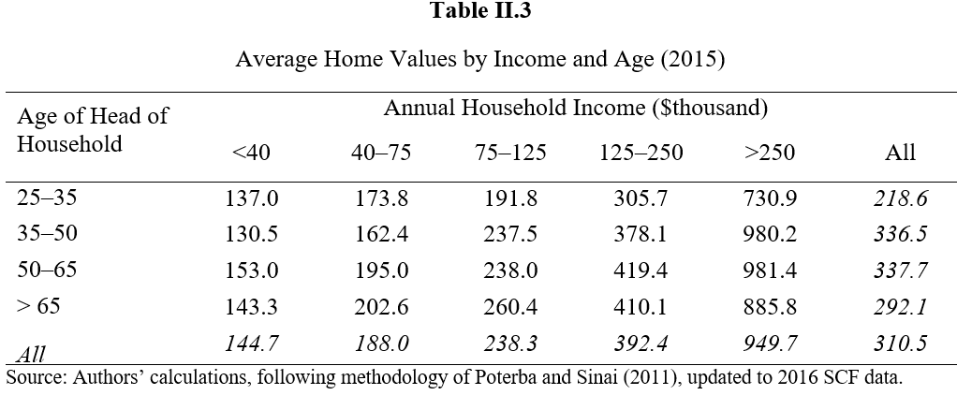
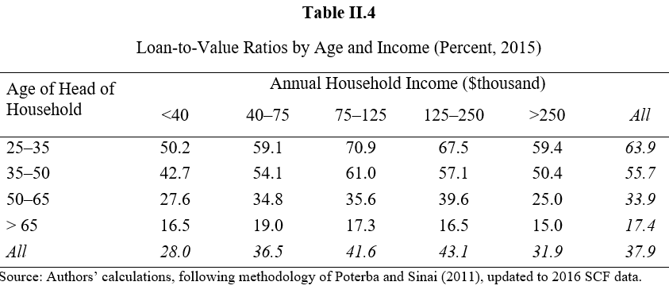
Background (Cont’d)
Poterba and Sinai (2011) use 2004 Survey of Consumer Finances (SCF), supplemented by TAXSIM (Feenberg and Coutts, 1993), classify households using a more comprehensive measure of income than AGI:
Measure of Income = AGI + income from non-taxable investments + employer contributions to social security + unemployment insurance and workers compensation + gross Social Security income + some additional preference items under the alternative minimum tax
Using this measure of income, we updated Poterba and Sinai’s results using 2016 SCF data.
Home value increases with income & age group LTV ratios decline at high income; flat or increase at lower income
Notes:
See age group 35-50

Slide 13
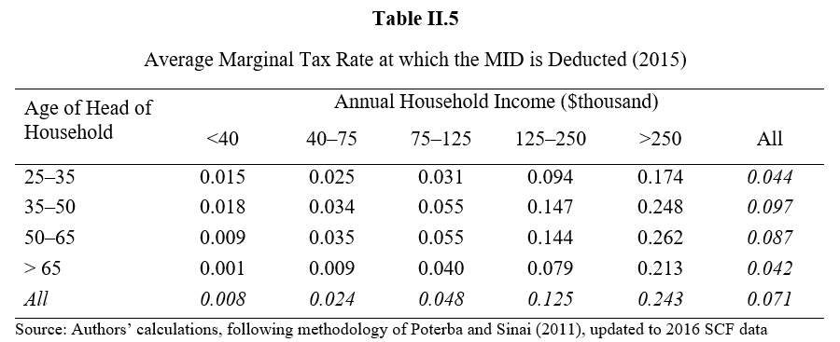
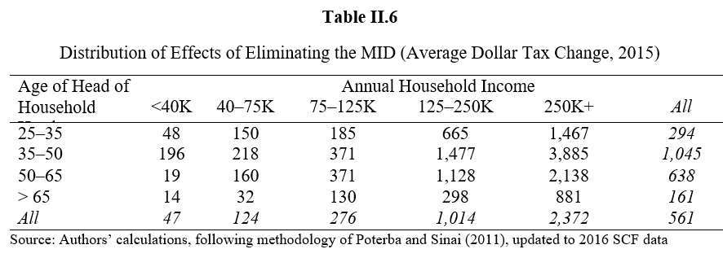
Background (Cont’d)
MID is more valuable to higher income taxpayers as they face higher marginal tax rates
Distributional effects of eliminating MID* - concentrated in the upper income classes
*Static effects of eliminating MID, neglecting behavioral effects.

Slide 14
III. Overview of the Model and Initial Equilibrium

Slide 15
Overview of the Model and Initial Equilibrium
Dynamic, overlapping generations, computable general equilibrium (CGE) model of the U.S. economy that focuses on the macroeconomic, distributional, and transitional effects of tax reforms
Consumers:
labor supply, consumption, and saving to maximize their welfare over a 55-year adult life
55 generations alive at any given point in time, and each generation includes 12 lifetime income groups, each characterized by its own lifetime earnings profile, government transfers profile, wealth holdings, consumption and saving patterns
Maximize lifetime utility (discounted sum of annual utilities) subject to lifetime budget constraint
Nested CES function with four consumer goods: a non-housing composite consumption good produced by the corporate sector (C), a non-housing composite consumption good produced by the non-corporate sector (N), owner-occupied housing (H), and rental housing (R)
Notes:
55 year adult life – 45 years of working and 10 years of retirement

Slide 16
Overview of the Model (Cont’d)
Business firms:
Firm managers maximize profits/value of firms
Calculate the optimal time path of investment for changes in the tax structure, considering adjustment costs
One firm for each production sector; Cobb-Douglas production function
Corporate sector (C), subject to CIT; non-corporate (N) and rental housing (R) sectors, taxed on a pass-through basis
Owner-occupied housing (H) sector: an untaxed private firm combines capital and labor to produce housing and then rents housing services to homeowners
MID benefits are incorporated into the model as reductions in the prices of housing services, which differ across income groups

Slide 17
Overview of the model (Cont’d)
Government: finances an exogenously specified time path of public services and government transfers
Tax instruments: CIT and a personal income tax with a progressive wage income tax structure (modeled as different constant marginal tax rates applied to the labor income of each of the 12 income groups), and a single constant rate capital income tax rate.
After the enactment of reform, the model will arrive at a steady state equilibrium where all key macroeconomic variables (GDP, outputs in various sectors, capital stock, effective labor force) grow at the steady state rate – an exogenously defined constant rate equals to the sum of population growth rate and the rate of technological growth
Reform induced changes in asset values in each market, for each period after the reform can be calculated – can consider changes in tax treatment of existing capital assets, as well as their previous tax treatment under the existing tax system – transitional effects on prices of housing and other assets and redistributions across all generations
Notes:
Public services is assumed to be separable from individual lifetime utility function; G transfer is included in individual income.

Slide 18
Initial Equilibrium
Initial equilibrium: a stylized representation of the U.S. economy in 2016
The last decade has been characterized by a boom, a bust, and then a recovery in the housing sector
The excess supply of housing in 2009 has dissipated and possibly reversed:
Vacancy rates of housing averaged 1.6 percent in 1980 and 1990s*.
Vacancy rates averaged 2.7 percent in 2007-2009, have been declining since 2010 – and were 1.8 percent in 2016.
Over the last five years to 2017, total housing inventory has been below 6-month inventory levels.** In August 2017, the total housing inventory declined to 1.88 million, which is 4.5 months of supply.
Our model is an equilibrium model, hence cannot model excess demand (might put upward pressure on housing price), but this effect needs to be considered together with the potential housing price declines for MID revisions
Might be offsetting effects – combined effect on housing prices would be smaller than similar policy implemented a few years ago, or in an equilibrium environment
*U.S. Bureau of the Census. **National Association of Realtors (NAR)

Slide 19
IV. Simulation Results

Slide 20
Simulation Results
Assume the revenue gains from curtailing or eliminating the MID are offset by increases in government transfers
Allows us to focus on isolating the effects of changes to MID…, and
No need to analyze simultaneously the distortionary effects of offsetting changes in other taxes or government deficit
Allows us to focus on substitution effects with income effects roughly offset by the reduction in government transfers
Consider dynamic changes – eliminating / curtailing MID would eliminate / reduce the tax advantage favoring borrowing in the form of a home mortgage
Reform creates incentives for portfolio adjustment - households with mortgage debt and financial assets that generate taxable income would be borrowing at the before-tax interest rate but investing at the after-tax interest rate
Incentive to pay down mortgages by drawing down their holdings of financial assets
Static estimates of the revenue gains from eliminating or curtailing MID overstated:
direct revenue gains;
indirect revenue losses might also be incurred: a decline in taxable interest, dividends, and capital gains on financial assets.

Slide 21
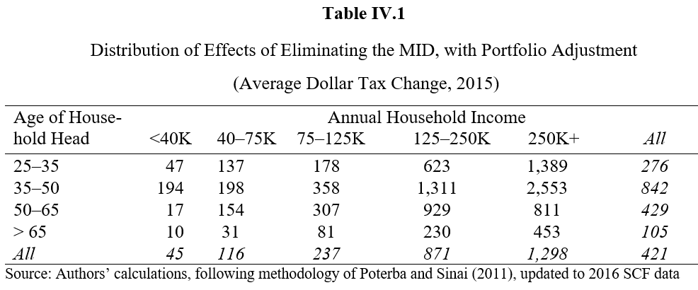
First Policy Change: Eliminating the Home MID
Poterba and Sinai (2011): many households with large mortgages have only limited capacity to rebalance due to limited financial wealth, while households with significant financial wealth typically do not have large mortgage
This limits the portfolio adjustments that might occur to reduce MID if it is reduced or eliminated
Amount of deductible mortgage debt that could be replaced by drawing down all available “non-transaction” liquid financial assets (liquid financial assets other than savings, money market, and brokerage call accounts) if eliminating MID: 20 percent
Updated this result to 2016 SCF data and generated a reduction in the static revenue gains if eliminating MID: 25 percent.
*Gervais and Pandey (2008) estimated the effect to be 25 percent whereas Gale, Gruber, and Stephens-Davidowitz (2007) generated an estimate of 16 percent.

Slide 22
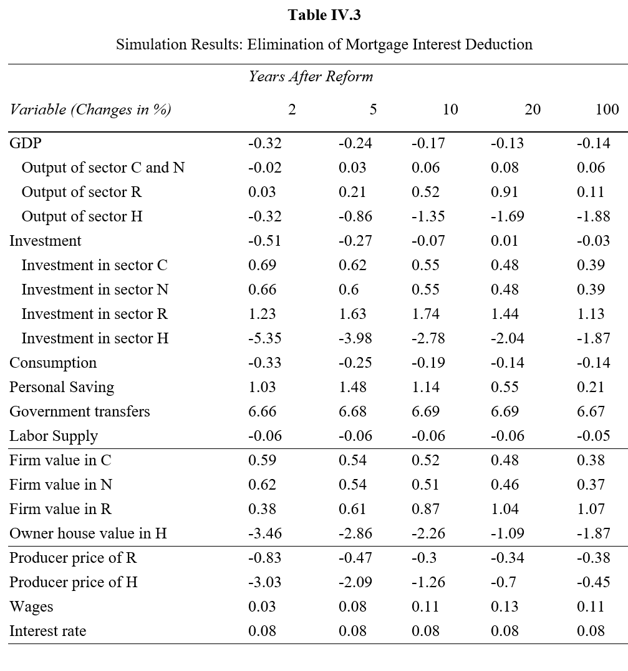
First Policy Change: Eliminating the Home MID
The overall effects of eliminating MID: generally small and negative in the short run
reflecting the costs of adjusting the capital stock
small and neutral in the long run
reflecting the efficiency gain from reducing the tax preference for owner-occupied housing

Slide 23
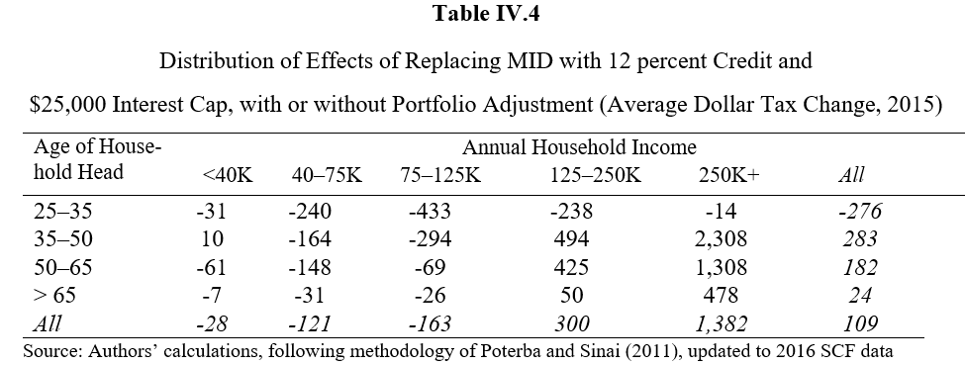
Second Policy Change: Converting the MID to a capped 12% credit
Converts the MID to a nonrefundable 12 percent tax credit and caps the MID at $25,000 per year
Average change in tax liability of moving to the credit/cap, with or without the portfolio adjustment: only 26 percent of the average change in tax liability of completely eliminating the MID with the portfolio adjustment
However, low income households benefit because they receive tax credit whether or not they itemize
*As an approximation to the effects of a loan cap of $500,000.

Slide 24
Second Policy Change: Converting the MID to a capped 12% credit
The overall effects of replacing the MID with a 12% credit and a $25,000 interest cap:
Qualitatively similar to the first policy change
Quantitatively smaller than the size of the first policy change

Slide 25
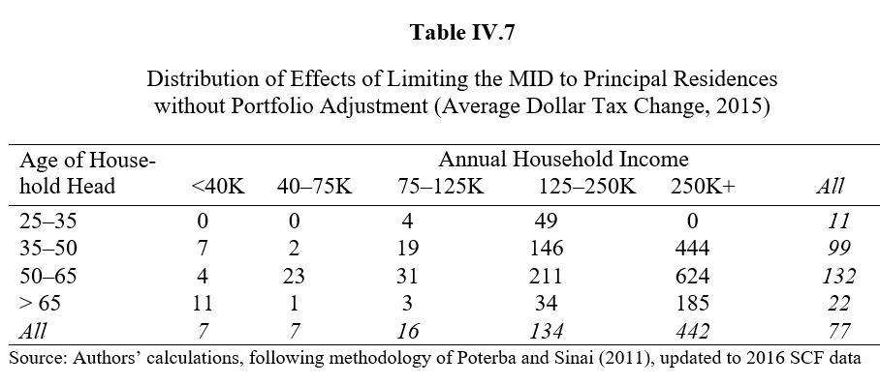
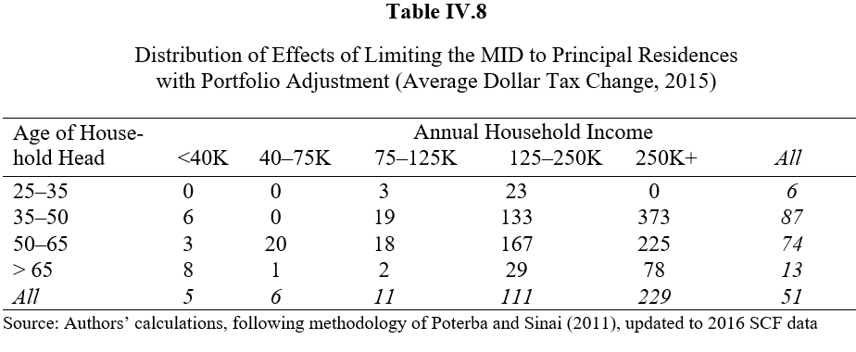
third Policy Change: limiting the MID to principal residence
The third policy suggested to limit MID is to disallow deductions for second and vacation homes and for home equity loans
This will include not only loans on traditional second or vacation homes, but also for loans on “transitional” homes – unsold homes used to be a primary residence before moving to a new primary residence

Slide 26
third Policy Change: limiting the MID to principal residence
The overall effects of limiting MID to principal residence:
Qualitatively similar to the first and second policy change
Quantitatively smaller than the size of the first and second policy change

Slide 27
V. Conclusion

Slide 28
Conclusion
Although MID unlikely to be eliminated, a redesign of the system to improve its effectiveness in conjunction with the effort to reduce the deficit and the national debt is crucial
We use a dynamic, overlapping generations, computable general equilibrium model of the U.S economy to simulate both the short run and long run dynamic macroeconomic effects of such proposals, including their effects on the housing market, such as changes in housing prices, housing investment, and the mix of owner-occupied and rental housing, as well their effects in several other dimensions
Elimination of MID: most key macroeconomic indicators decrease slightly in the short run, and the effects are neutral in the long run
Housing sector investment, housing value, and producer prices of housing decline in the short run and the magnitude of reduction is smaller in the long run
Results are qualitatively similar for the other two policy changes, but the results are smaller

Slide 29
Questions?

